Slide 1
Comprehensive Assessment
Hospital Management App
Shashwat Pathak
shashwat.pathak@mindtree.com
Notes:
Hello, I am Shashwat and I am presenting my work on the comprehensive assessment. So, let’s begin with the introduction

Slide 2
Introduction
This project is part of the final comprehensive assessment in which we have developed a full stack web application using Spring Boot, MySQL, and Angular
Notes:
This project includes the API development using spring boot and MySQL database, the frontend using Angular and finally using jenkins for CI/CD deployment.

Slide 3
Table of contents
Spring Boot Backend
Angular Frontend
01
02
Test Cases
Jenkins GitHub Integration
03
04
The setup and overview of the backend
The setup and overview of the frontend
The test cases on backend and frontend
Continuous Integration/Deployment using Jenkins
Notes:
I have divided this presentation into 4 sections, starting with the spring boot API design, followed by the frontend designed in angular and then the results of running the test cases and finally the Jenkins integration of the code uploaded on github.

Slide 4
01
Spring Boot Backend
Notes:
Starting with the project setup

Slide 5
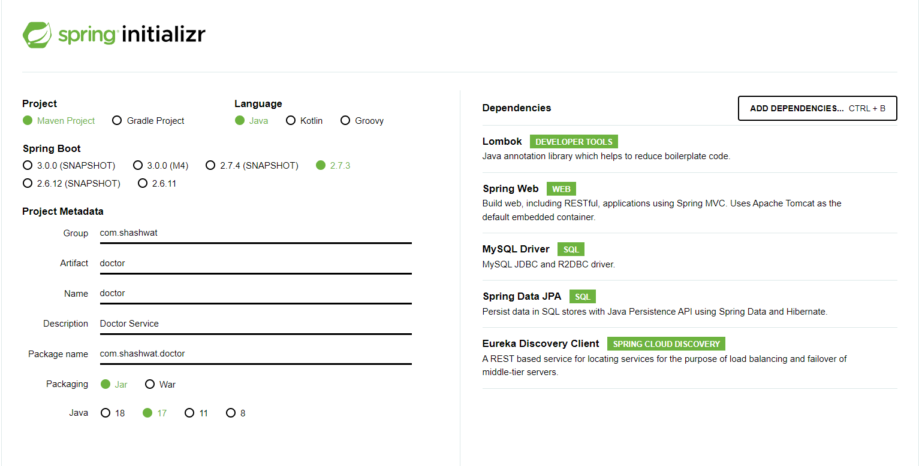
Creating the doctor service project
Notes:
For creating the spring boot project I visited start.spring.io and created several projects starting with the doctor service and as we can see the dependencies which this project uses are Lombok, Spring web, MySQL driver, Spring data JPA and Eureka discovery client.
Lombok is a library which provides various annotations (Annotation is nothing but a way to provide metadata to our source code, they might not be directly part of the program they are used in. Some default annotations are @Override, @Deprecated etc.) which can be used to get rid of some of the most common repetitive tasks such as defining the constructors and getters/setters etc. The @Data annotation provides various other annotations like @Getter, @Setter etc. which is very useful when defining an entity.
Spring web provides some of the essential features like providing the HTTP client and event listeners.
MySQL driver provides the dependency which facilitates the connection of the application with the database.
Spring data JPA (JPA is a specification which standardizes the way java objects are mapped to a relational database which acts as an ORM (object relational mapping).) uses Hibernate implementation and it provides a framework which works with JPA and provides a complete abstraction over data access layer.
Finally Eureka discovery client is the dependency which is used for discovery of connected services, which is important for health check of services.

Slide 6
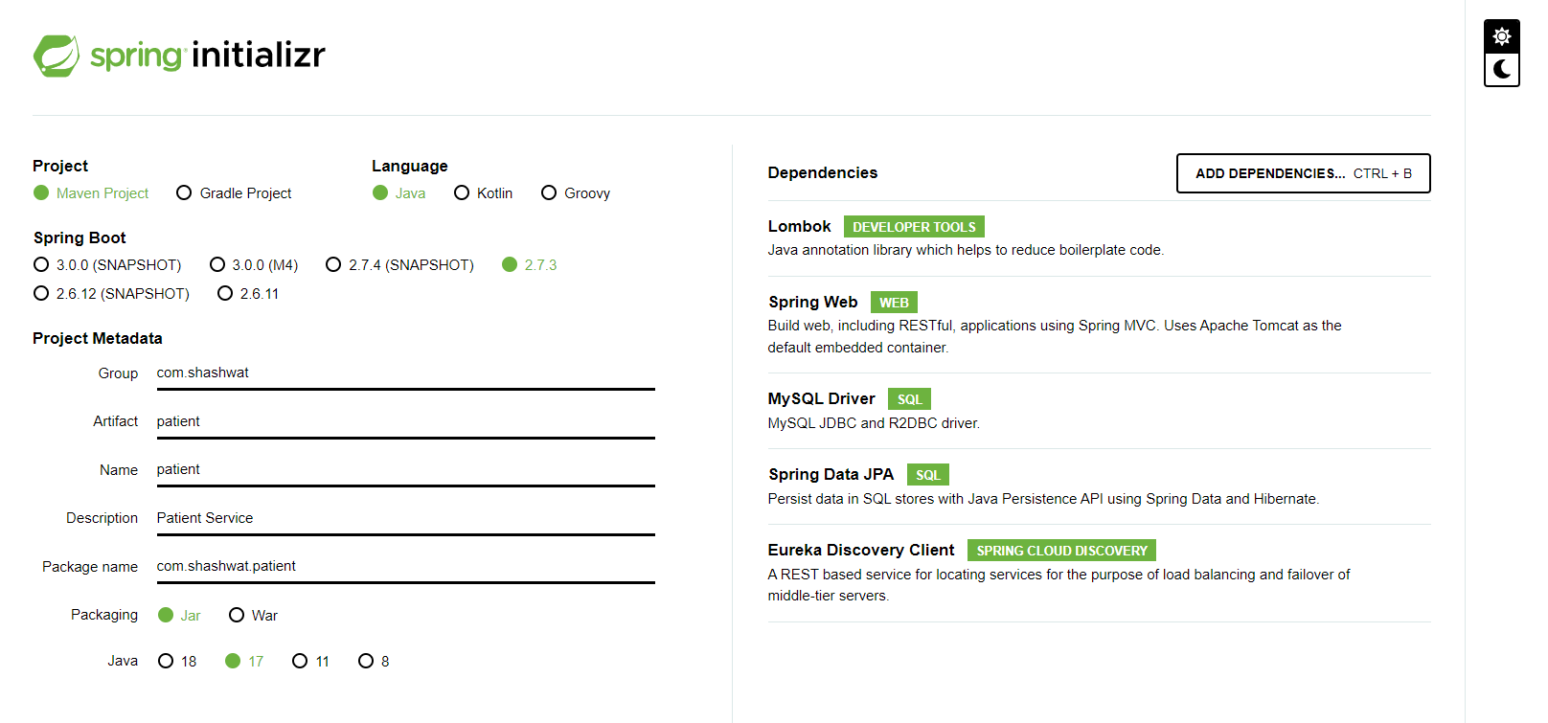
Creating the patient service project
Notes:
Similarly, we create the patient service.

Slide 7
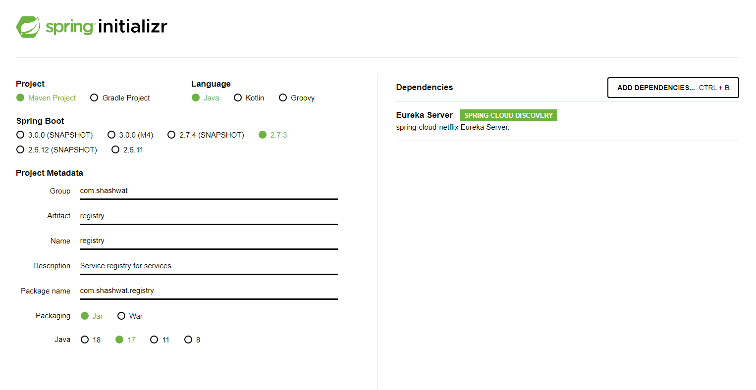
Creating the service registry
Notes:
Now, we create the project for service registry which will keep track of all the running services and this uses Eureka server as it’s core dependency.

Slide 8
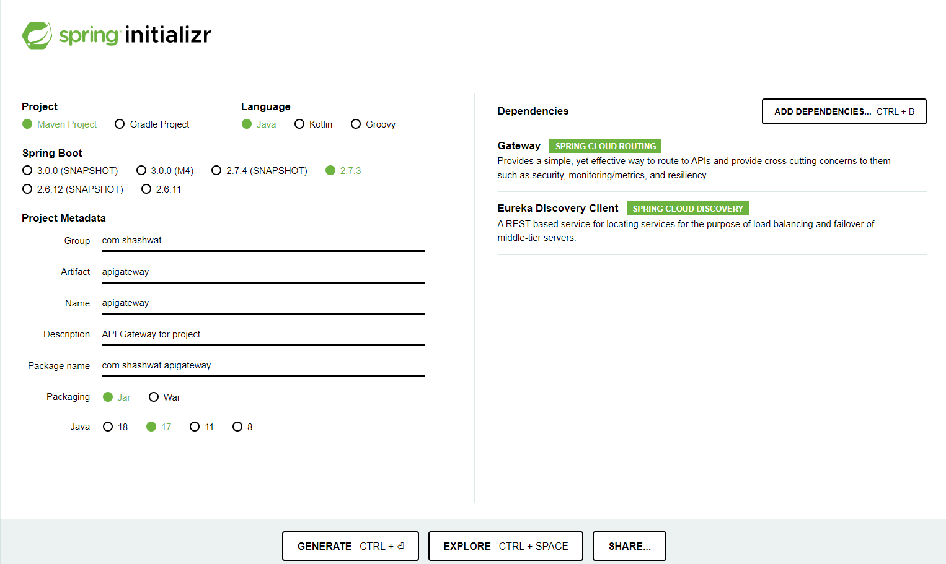
Creating the API Gateway
Notes:
Finally, we generate the API gateway project, which as the name suggests, acts as the gateway for the API calls from the client. The API gateway performs automated load balancing and helps in generalizing the API endpoints for many different services.

Slide 9
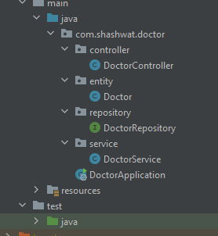
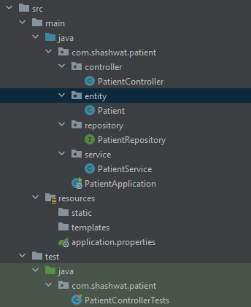
Implementing the services
The services are mainly categorized in four sub-packages – entity, repository, service, and controller.
Notes:
So, in the projects I have divided the code base into 4 different sub packages - entity, controller, service and repository.
Extra:
@Controller annotation means that this particular client acts as a REST controller and is responsible for processing incoming REST API requests.
@Entity annotation specifies that the class is an JPA entity and is mapped to a database table. The @Table annotation specifies the name of the database table to be used for mapping.
@Repository annotation is used to indicate that the class provides the mechanism for storage, retrieval, search, update and delete operation on objects. It acts as the database repository.
@Service annotation indicates that the particular class services as the service layer and has the core business logic in it.
Note: All the above are part of @Component annotation - which indicates any spring managed component.

Slide 10
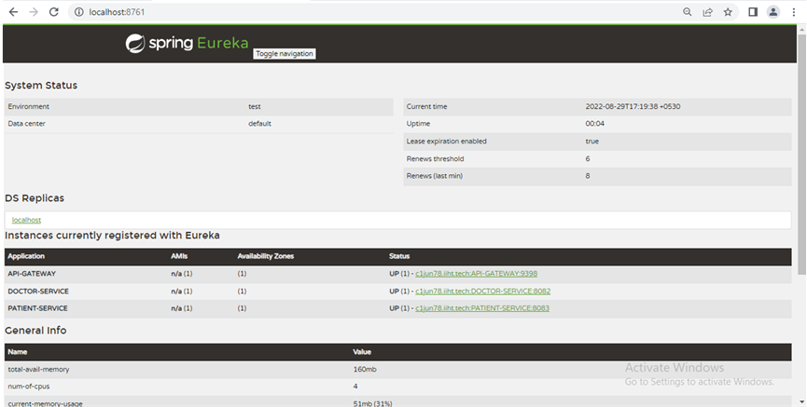
Eureka Dashboard
Notes:
When we run the project, we see this dashboard with all the services up and running.

Slide 11
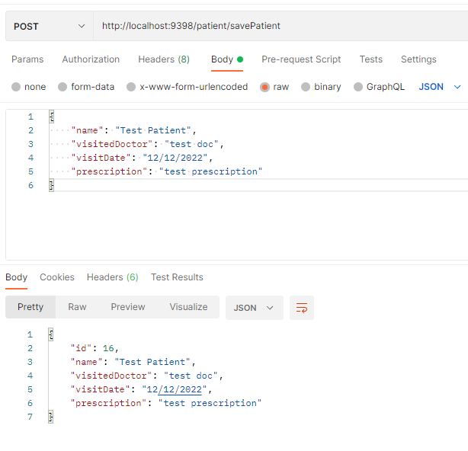
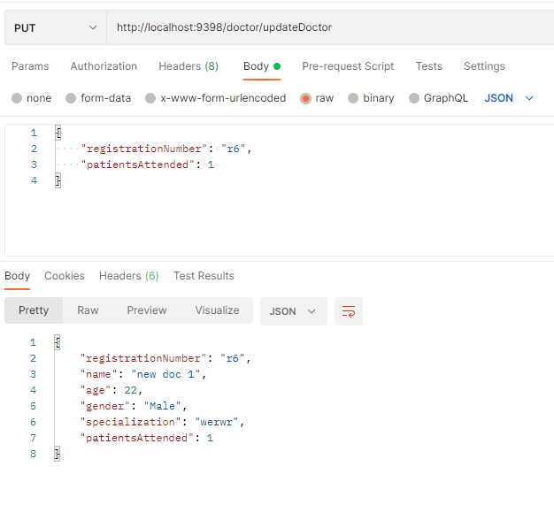
Testing the APIs in Postman
Notes:
These are some of the screenshots of testing the backend API to verify that they actually work.

Slide 12
02
Angular Frontend
Notes:
Now, we move on to the frontend implementation

Slide 13
Creating the Project
We can create the new angular project using `ng new` command, but we need to have Node package manager (NPM) and Angular CLI installed before we can do that.
So, after installing Node on our machine, we can install Angular CLI using command `npm install -g @angular/cli`.
Once angular CLI is installed, we can create new project using `ng new <project name>` command.
This generates a project with dummy codebase, which we have to modify as per our needs.
Notes:
Same as in slide

Slide 14
Creating the components
In this project, I have created following components -
Home screen
Doctor enrollment form
Patient enrollment form
Search doctor info screen
Search patient info screen
We can create new components in angular by running command -
`ng generate component component/component-name` from the root folder.
Notes:
Next we create the components in the angular app, which are nothing but the collection of markup design, styling and a controller.
Continue as in slides

Slide 15
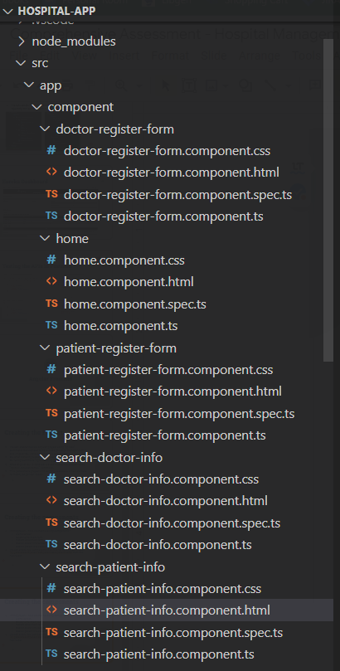
Creating the components
Notes:
This is the folder structure as seen in VS Code we can see the components have 4 different files which are generated.

Slide 16
Creating the entity
In this project, I have created two entities -
Doctor
Patient
We can create a new entity in angular simply as a new class by running command -
`ng generate class entity/entity-name` from the root folder.
The entities in this project look like as shown in the next slide.
Notes:
As in the spring boot part, in angular also, we need to represent the entities used in the application.
Continue as in slides.

Slide 17
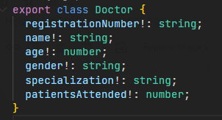
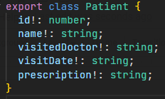
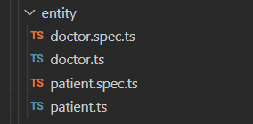
Creating the entity
Notes:
These are the entities used in the angular project along with the folder structure of the generated entities.

Slide 18
Creating the service
In this project, I have created two services -
Doctor service
Patient service
We can create a new service in angular simply as a new service by running command -
`ng generate service service/service-name` from the root folder.
The services are used to call the backend APIs and the components use the services to perform various backend operations.
Notes:
Now, in order to make the API calls, we need to implement the service in angular as well, where we can make use of the HttpClient library included in angular core library to make API calls using various HTTP methods like get, post, put etc.

Slide 19
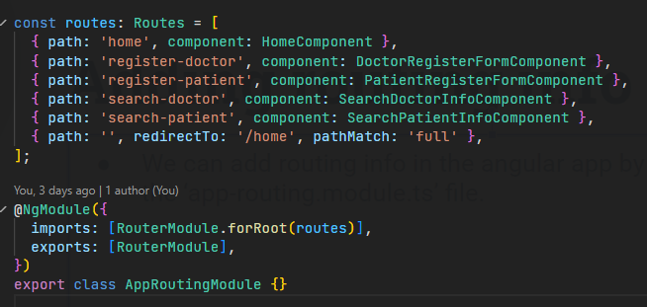
Adding routing info
We can add routing info in the angular app by defining the routes in the ‘app-routing.module.ts’ file.
Notes:
In the app I have added different routes which display a particular component, and the routes can be easily defined in the app-routing.modules.ts file in the exported routes object.

Slide 20
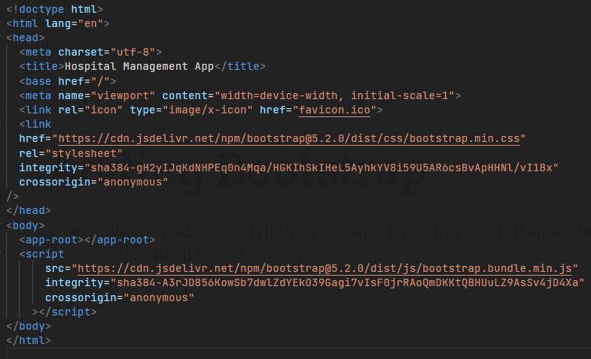
Adding Bootstrap
We can add the styling in our app by using bootstrap in the index.html file as shown
The <app-root> tag is where angular pushes the dynamic screen content.
Notes:
I have also used bootstrap for styling the HTML, for which I have added the CSS link in the head and the corresponding bootstrap JS within the script tag in the body.

Slide 21
Running the Application
We can run the application using `ng serve` command, which launches the project on the localhost.
Once the application is running, we can see the home page as shown in the next slide
Notes:
Same as in slides

Slide 22
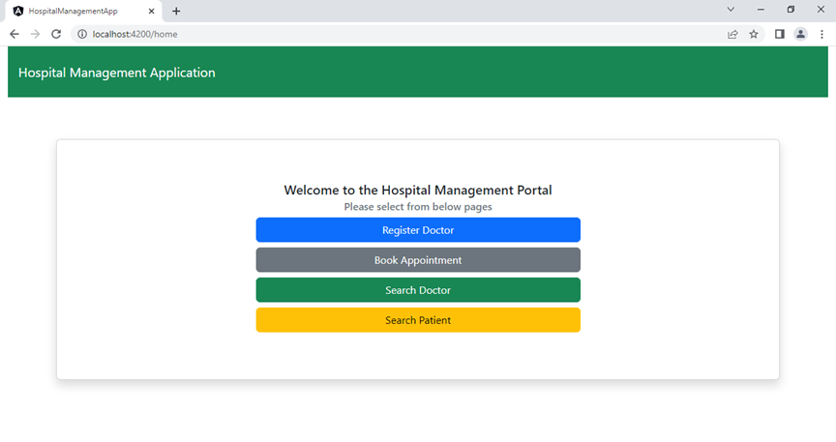
Home page
Notes:
This is the homepage of the application, which is rendered from the Home component and it has links to various different components, which the user can click and go to. There are 4 buttons, clicking on which we land on the doctor or patient registration forms or on the search screens. First let us try to create a new doctor in the system.

Slide 23
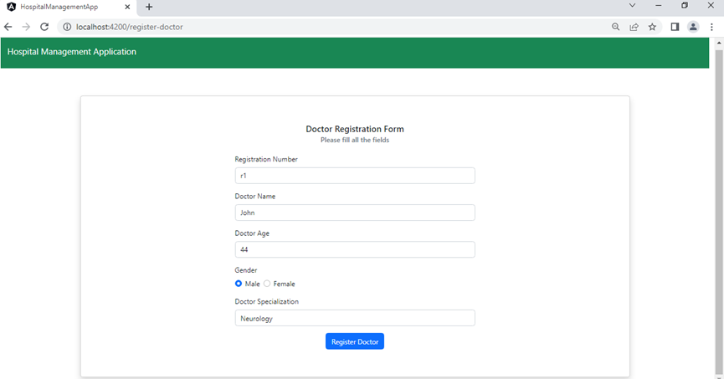
Adding a doctor
Notes:
We have added the doctor information, and then we click on the register doctor button to create a new doctor.

Slide 24
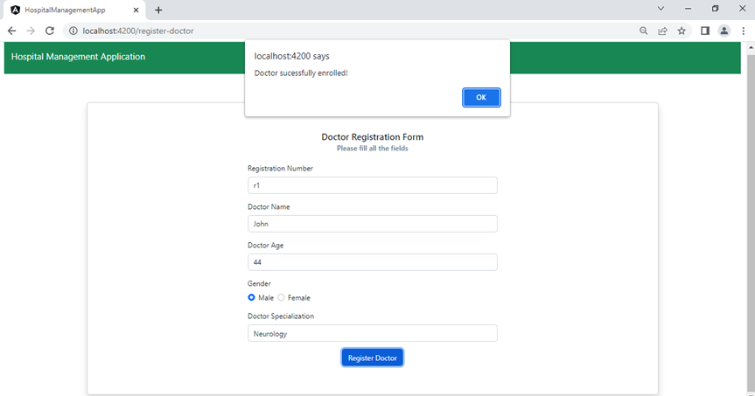
Doctor added
Notes:
If the doctor is added successfully, alert confirming the same is shown and we get routed back to the home page.

Slide 25
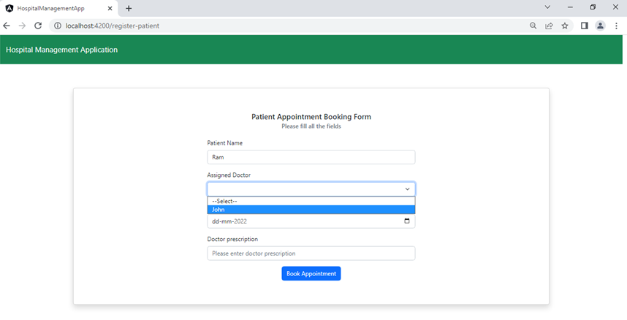
Adding a new patient
Notes:
Next, let us try adding a new patient for booking an appointment, so in the doctor dropdown we can see that the name of the doctor is visible

Slide 26
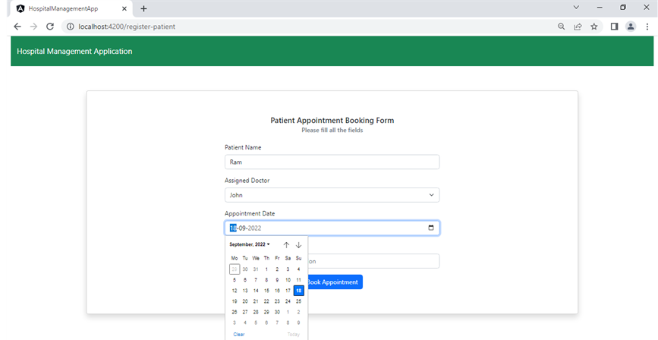
Adding a new patient
Notes:
Next, we can select the date

Slide 27
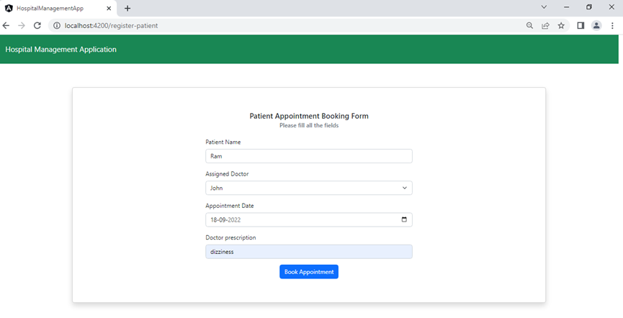
Adding a new patient
Notes:
And once the prescription information is added in the field we can click on the book appointment button

Slide 28
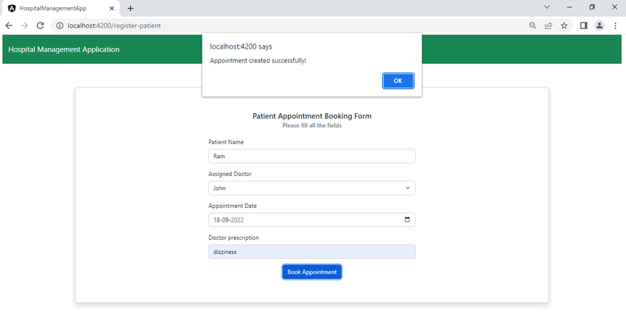
Patient added
Notes:
And if the patient is registered and the appointment is booked, we get the alert for the success

Slide 29
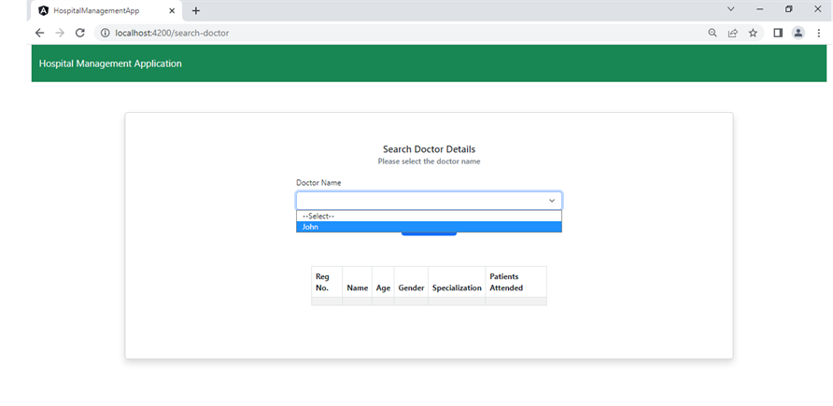
Search doctor info
Notes:
Now, let’s go back to the homepage by clicking on the app name on the nav bar and search for the current doctor information. As we can see we get the name of the currently added doctor and after selecting the doctor, we click on fetch details button below the dropdown

Slide 30
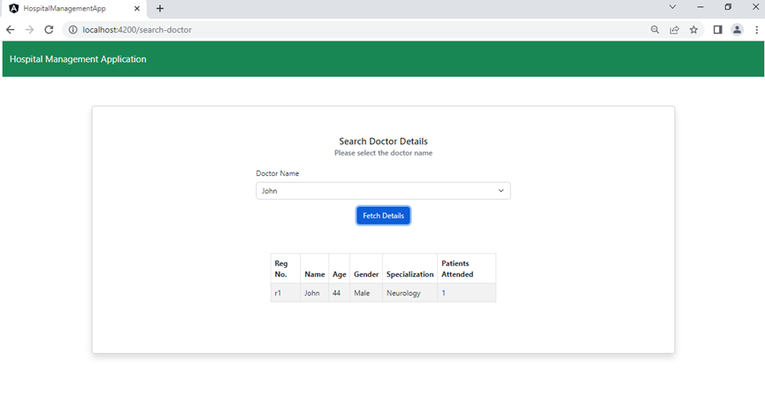
Search doctor info
Notes:
And we get the information of the doctor

Slide 31
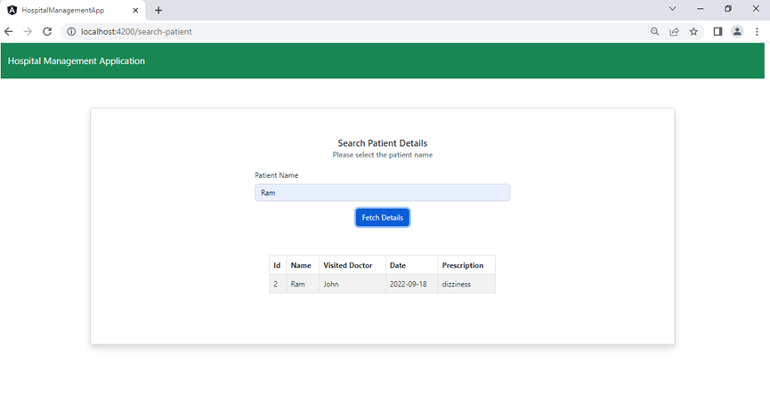
Search patient info
Notes:
Similarly, we can search for the patients by entering their name in the text field, if a successful match is found, the name is populated in the table below

Slide 32
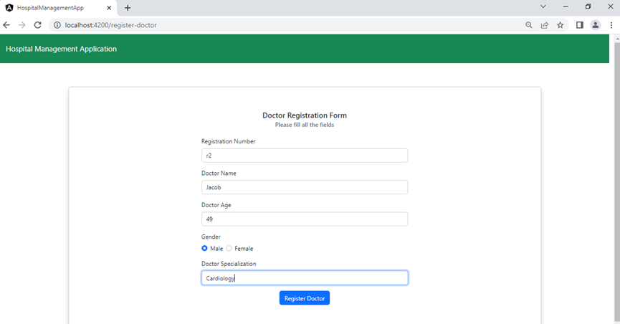
Adding a new doctor
Notes:
Now, let’s add another doctor in the same way

Slide 33
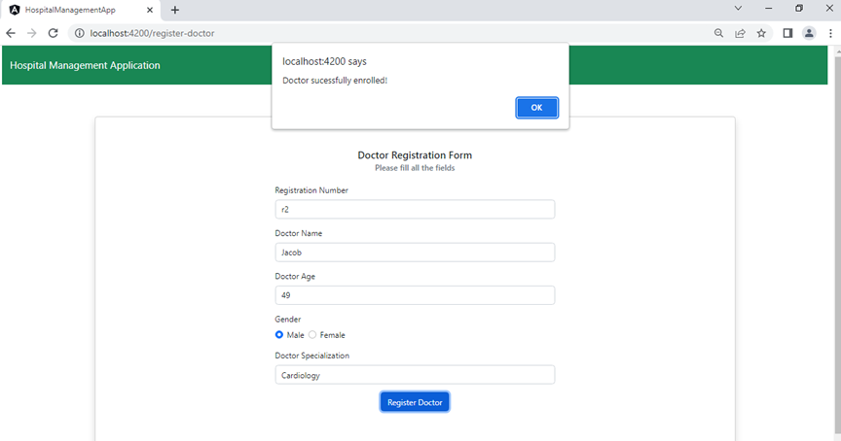
New doctor added
Notes:
The doctor is added

Slide 34
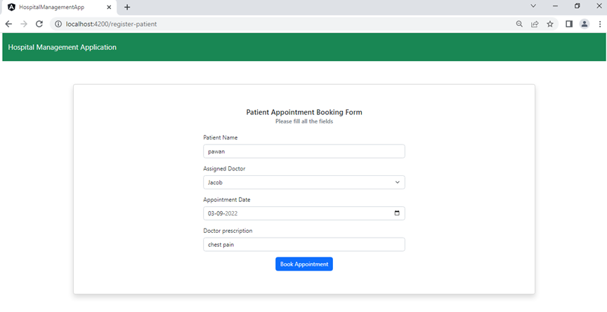
New patient registration
Notes:
We create a new patient appointment information

Slide 35
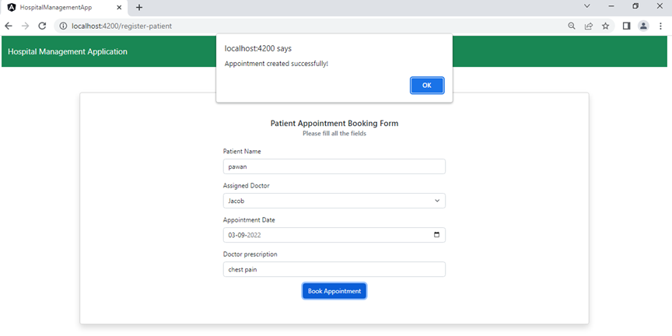
New patient registered
Notes:
And the new patient is registered

Slide 36
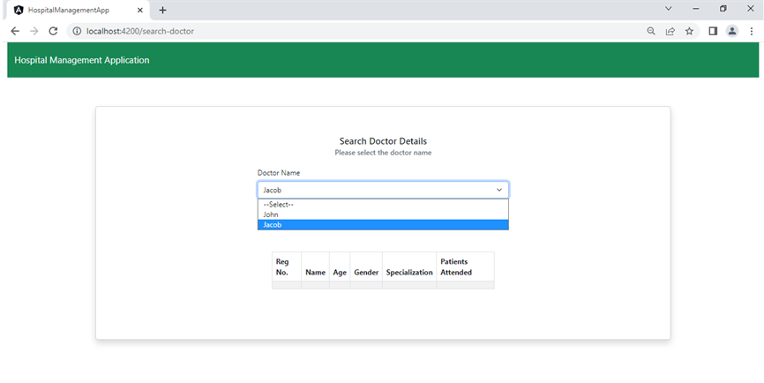
Search doctor info
Notes:
If we go to the search doctor details information page now, we see both of the doctor names getting rendered.

Slide 37
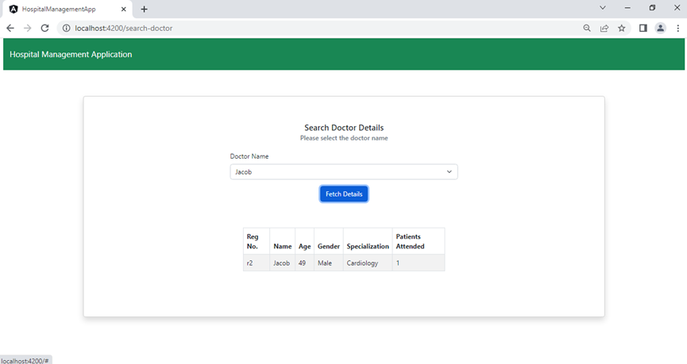
Searched doctor info
Notes:
We can select either one of them to fetch the information.

Slide 38
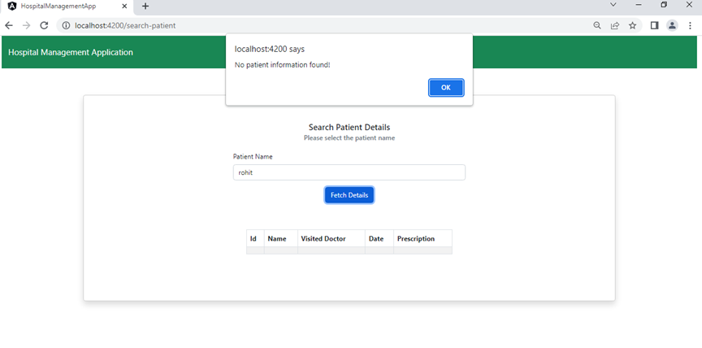
Invalid patient search
Notes:
Now, in case we search for any non existing patient, we get the alert with message that the patient information is not found.

Slide 39
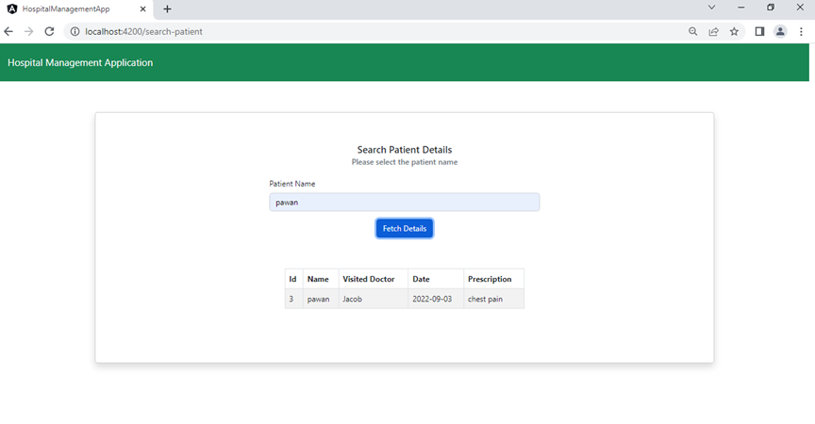
Valid patient search
Notes:
For valid cases, we get the response as expected.

Slide 40
03
Testing using JUnit and Karma
Notes:
Now, The test cases we added both in the case of the backend API and the frontend app, we added test for each of the controllers in the backend using JUnit and in using Karma/Jasmine in Angular app.

Slide 41
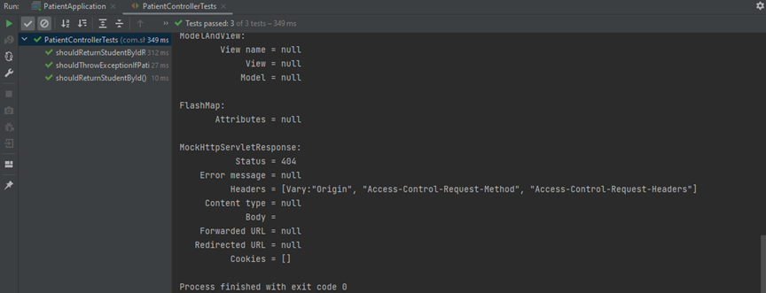
Tests for Patient Controller
Ran 3 tests for the controller, for validating the response
Notes:
I added 3 tests to validate the response of the API, all of which are passing as shown in the screenshot

Slide 42
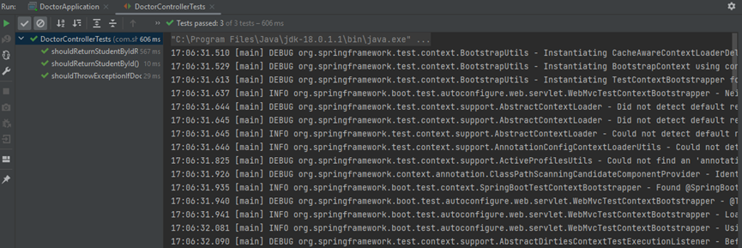
Tests for Doctor Controller
Ran 3 tests for the controller, for validating the response
Notes:
Similarly, for the doctor controller the tests passed correctly.

Slide 43
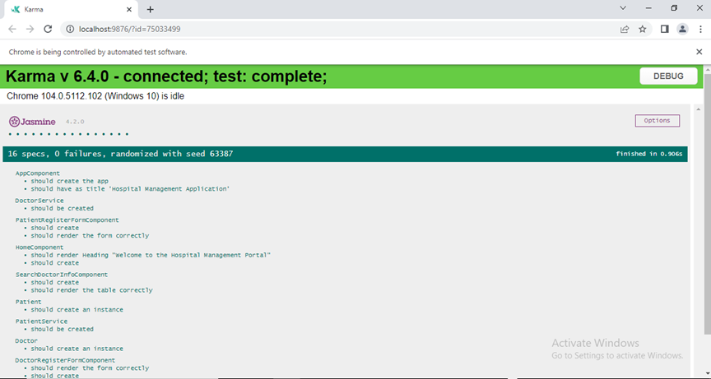
Karma Test results
Notes:
We can run npm run test command to run the test suite. In angular, the tests added were to justify if the forms and the components are loaded properly, and a total of 16 tests, which includes 8-9 predefined tests, we get the result as in the screenshot.

Slide 44
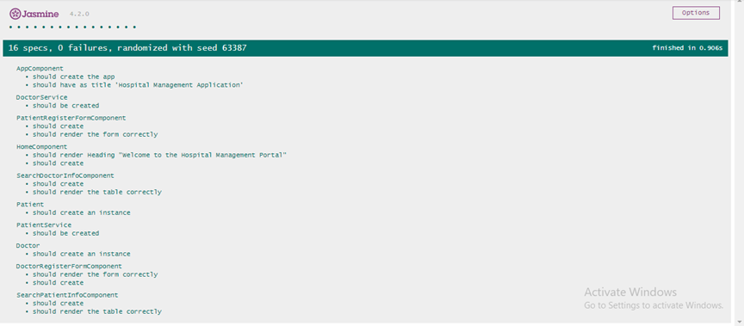
Karma Test results

Slide 45
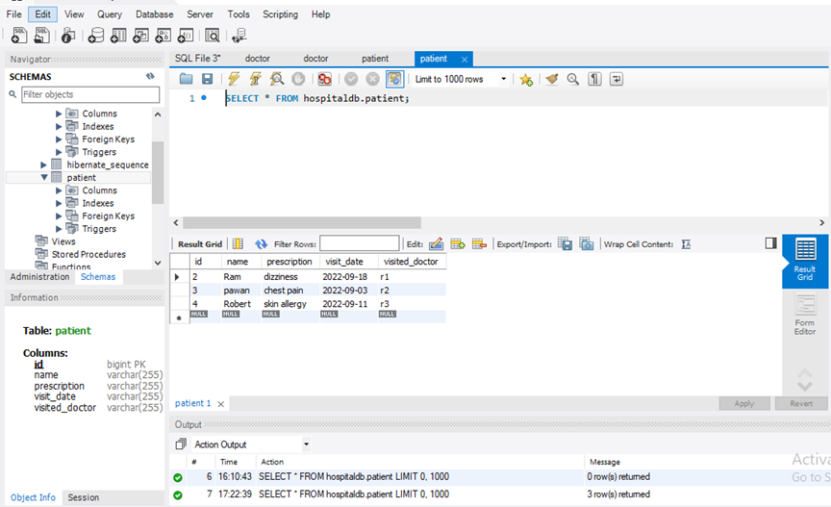
Final Database values
Notes:
Here are the final database values as well.

Slide 46
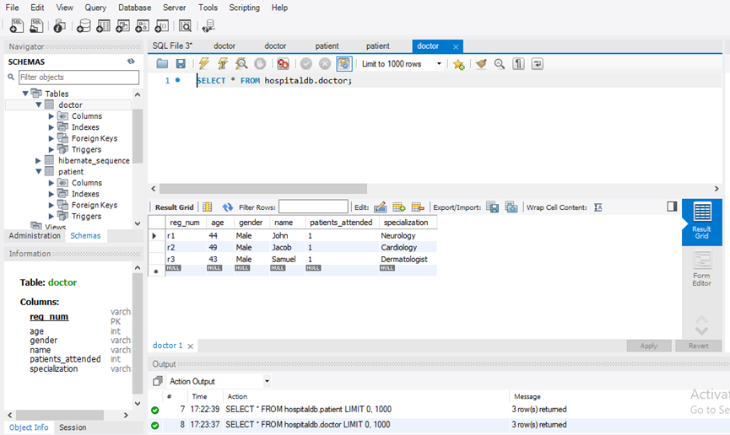
Final Database values

Slide 47
04
CI/CD using Jenkins
Notes:
Now on the last part, I created the Jenkins job to automatically run once updated code is pushed on the corresponding github repository for both of the services which are used in the application.

Slide 48
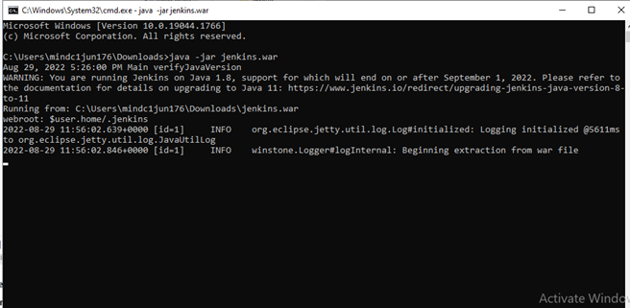
Running Jenkins
We can download Jenkins as a war file, and can run it using `java -jar jenkins.war` file as shown below
Notes:
We can download Jenkins either as a platform specific binary or as a web archive (war) file and run it using `java -jar jenkins.war` command

Slide 49
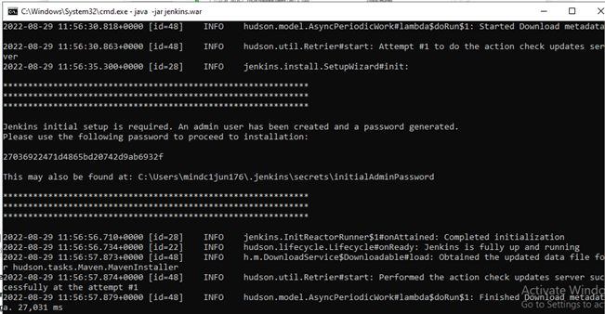
Running Jenkins
Finally we get the password at end of initial run, we can open localhost:8080 at this point to see the Jenkins UI and we enter the password displayed to move forward
Notes:
Finally, before we access the Jenkins UI we need to unlock it and we get the password generated on the command prompt and we copy this password and paste it in the UI which can be accessed on localhost port 8080

Slide 50
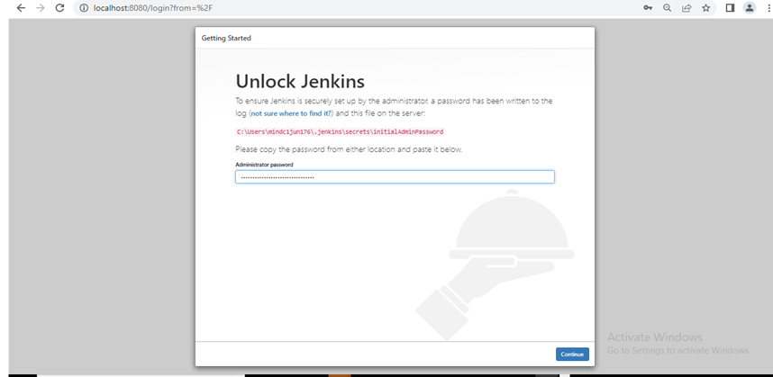
Running Jenkins
Notes:
This is where we paste the password

Slide 51
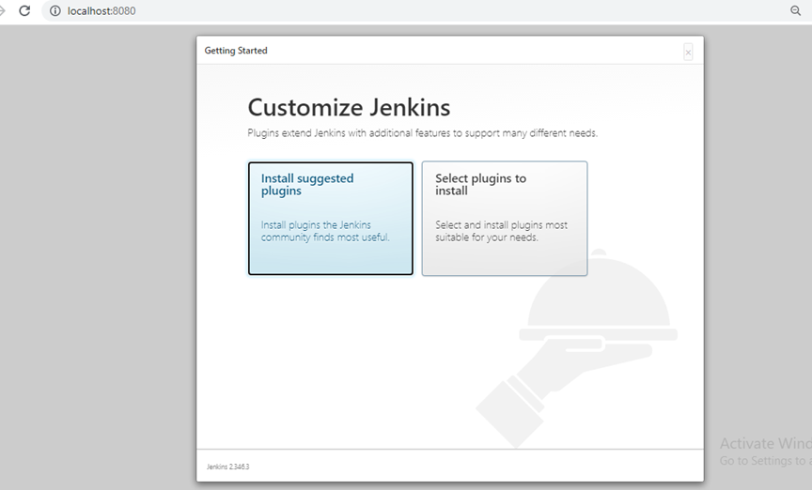
Adding default plugins
Notes:
Next, we install the suggested plugins

Slide 52
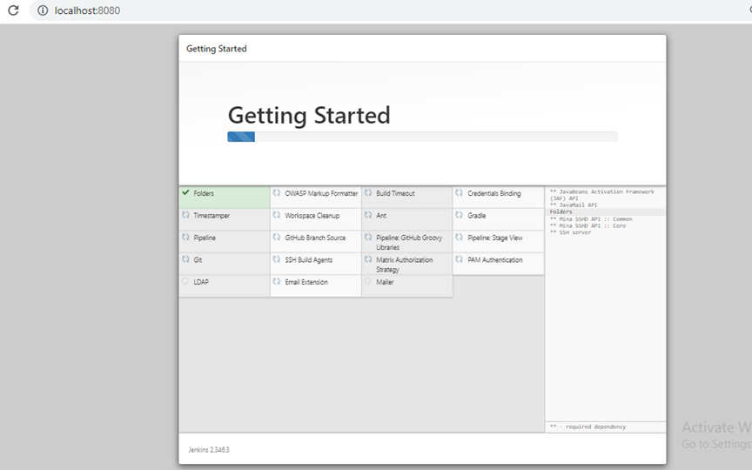
Adding default plugins
Notes:
The plugins get installed in some time

Slide 53
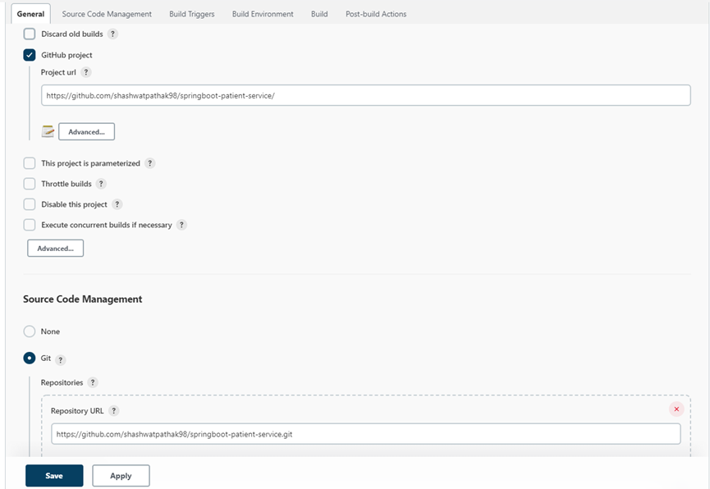
Creating a new job
Notes:
Now on the dashboard we can click on new item button and create a new freestyle project with details as shown. We enter the github repository URL in the field above and in the source code management section, we enter the URL of the git repository.

Slide 54
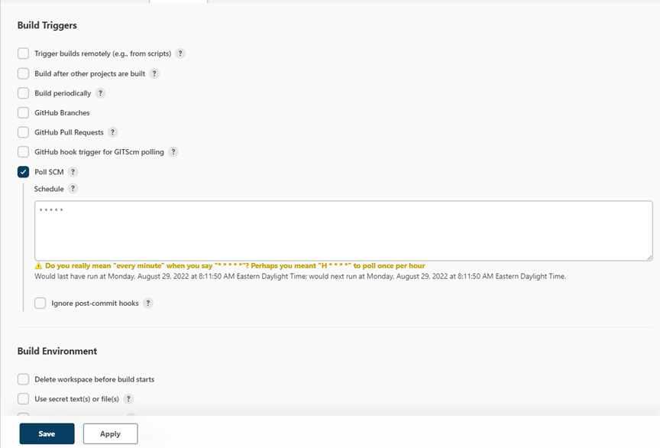
Creating a new job
Notes:
In the build triggers section, for this project, we have polled the git repository for every minute, but ideally we can set to half an hour or more as per the need.

Slide 55
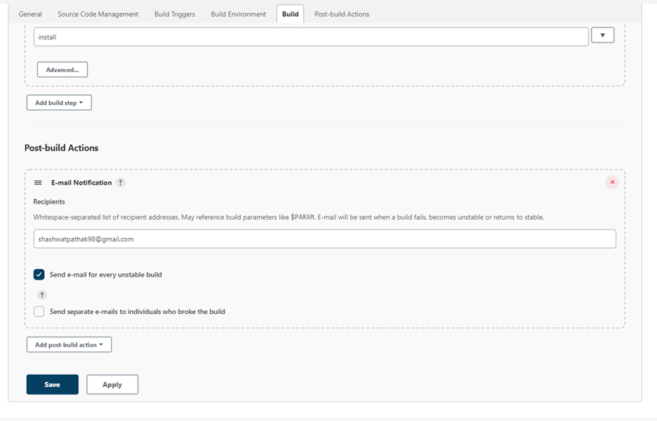
Creating a new job
Notes:
Next we add the build steps, where we can specify the maven clean and install or package commands to run in order to validate the build. We can also add a post build action if we want to and we save the job. We similarly follow the same steps for the next service.

Slide 56
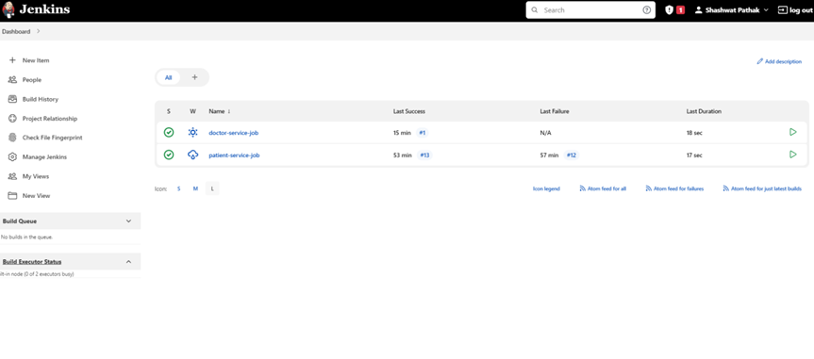
Jenkins Dashboard
Notes:
Finally, we see the dashboard like this - as soon as a new commit is pushed in github the build automatically starts within or near about in a minute.

Slide 57
Thanks!
Notes:
So, this was all from my implementation of the comprehensive assessment. It was a great way to learn and explore various new concepts and it gave me a very good overall idea about the complete full stack application development. Thanks so much!

